Slide 1

Introduction to Stratus
Why Smart Controls Matter
Notes:
Stratus represents the next step forward in AAON controls, designed to simplify complexity while delivering smarter, more connected performance. Today, we’ll talk about why controls matter more than ever, how Stratus brings everything together into one ecosystem, and how it benefits everyone involved, from owners to occupants to service teams

Slide 2
AGENDA
Stratus Overview
Stratus Smart Controls
Stratus – Benefits for Everyone
Inside the Stratus Controls Ecosystem – Unit Manager
Precision Controls Mode
Standard Controls Mode
Stratus Features and Options

Slide 3
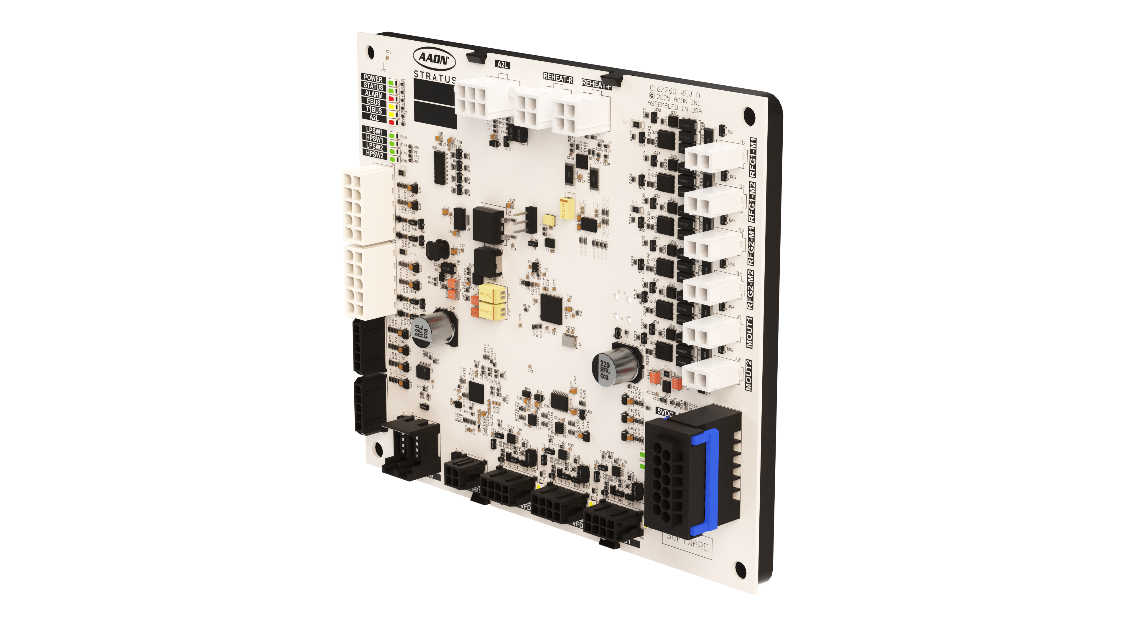
Stratus — Smart. Simple. Streamlined.
Stratus patent-pending technologies ushers in the next evolution of AAON controls.
An entire ecosystem that ties everything together.
Consolidates multiple control boards into one intelligent controller:
  — Air Handler
  — Outside Air
  — Cooling
  — Heating
  — Preheat
Notes:
Stratus replaces what used to be multiple separate control boards with a single, unified controller.

Slide 4

Why Controls are Critical
HVAC systems account for 40–60% of a building’s total energy use
Poor controls can lead to:
  — Energy waste
  — Occupant discomfort
  — Increased maintenance and service calls
Notes:
Even the best mechanical system can underperform if the controls aren’t up to the task. Controls determine how efficiently a unit operates, how comfortable a space feels, and how easy it is to maintain.

Slide 5

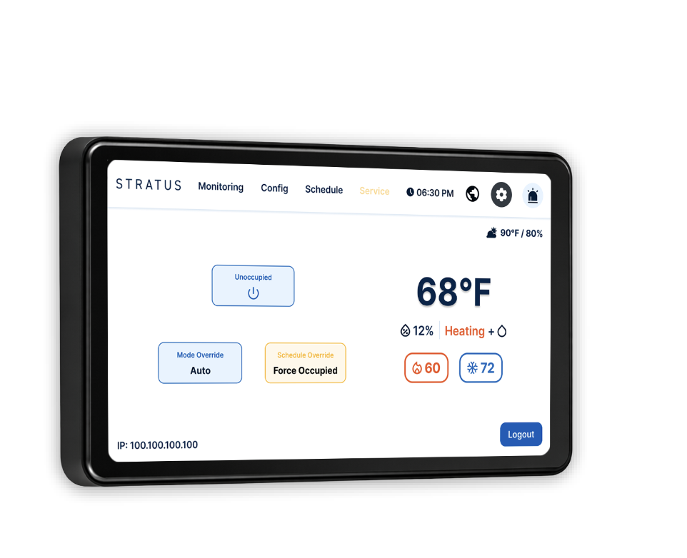


Benefits for Everyone
Stratus Controls Provide Benefits for Everyone
Building Owners
Remote access allows building owners to monitor performance and set schedules from their laptop or mobile device.
Occupants
More consistent comfort with intuitive, real‑time feedback.
Service Techs
Built-in touchscreen controller allows for easy scheduling, diagnostics, startup and maintenance.
Engineers/Architects
AAON units are built to your application, and
the controls are designed for your environment.
Not forced into a one‑size‑fits‑all solution.
Notes:
Owners gain visibility and control, occupants experience better comfort, service teams save time on troubleshooting, and engineers can confidently specify a system that aligns with the project’s performance goals.

Slide 6
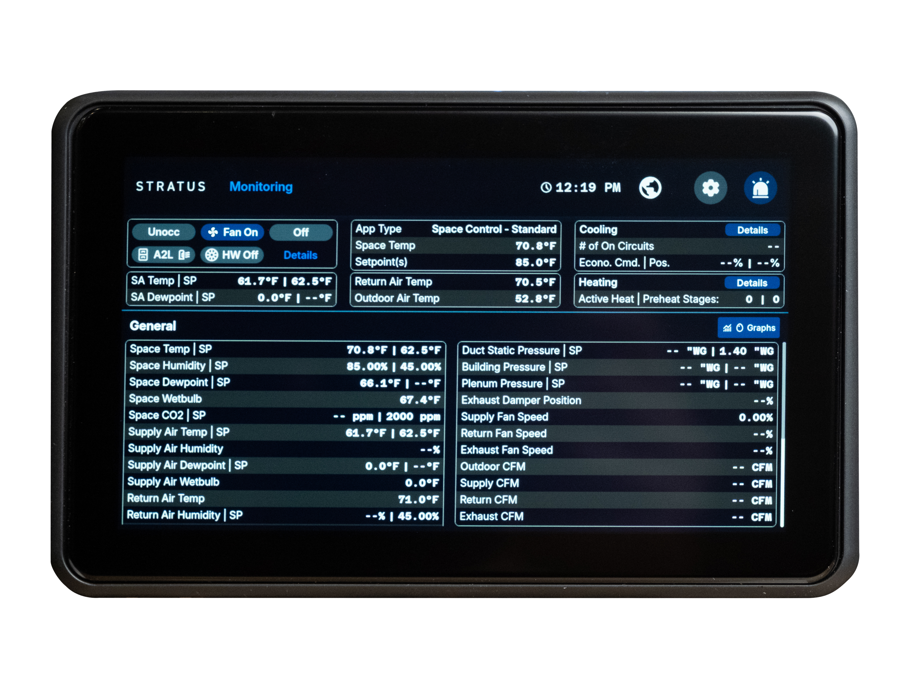
Inside Stratus — Unit Manager
Stratus unit manager is a high-resolution touchscreen offering:
  — Configuration Access
  — Diagnostics
  — Scheduling
Notes:
The Unit Manager is the primary point of interaction with Stratus. It eliminates the need for a laptop during startup or service and puts all critical information directly on the unit. With remote connectivity, many tasks can be performed off‑site, saving time and improving response speed.

Slide 7
Stratus: Precision Control Mode
Designed for spaces requiring tight environmental control, Precision Mode:
  — Maintains precise temperature
  and humidity levels
  — Supports seasonal setpoint adjustments that can be automatically adjusted for optimal performance
  year-round.
  — Is best for critical environments needing stability
Precision Mode is ideal for applications like labs or data centers, environments that are sensitive and require consistent specific conditions.
Notes:
Precision Mode is all about stability and accuracy. In spaces where environmental conditions are critical, Stratus continuously adapts to maintain tight tolerances.

Slide 8
Stratus: Standard Control Mode
Optimized for energy efficiency, Standard Mode uses a deadband between cooling and heating setpoints to minimize unnecessary system operation. Active conditioning is reduced within the neutral one, lowering the energy use required but still maintaining occupant comfort.
  — Prioritizes energy savings and comfort
  — Operates within a defined temperature range
  — Ideal for offices, classrooms, and general-use commercial spaces
Notes:
Standard Mode balances comfort with energy savings. By allowing a neutral zone between heating and cooling, the unit avoids excessive cycling. This approach reduces energy use while still maintaining a comfortable indoor environment for everyday spaces.

Slide 9
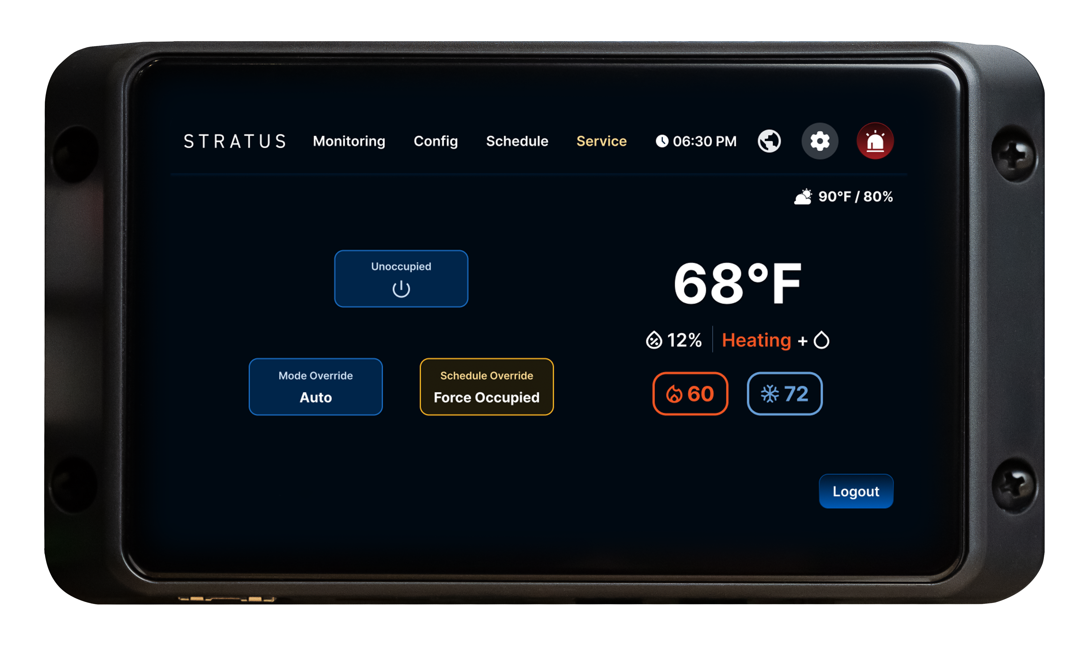
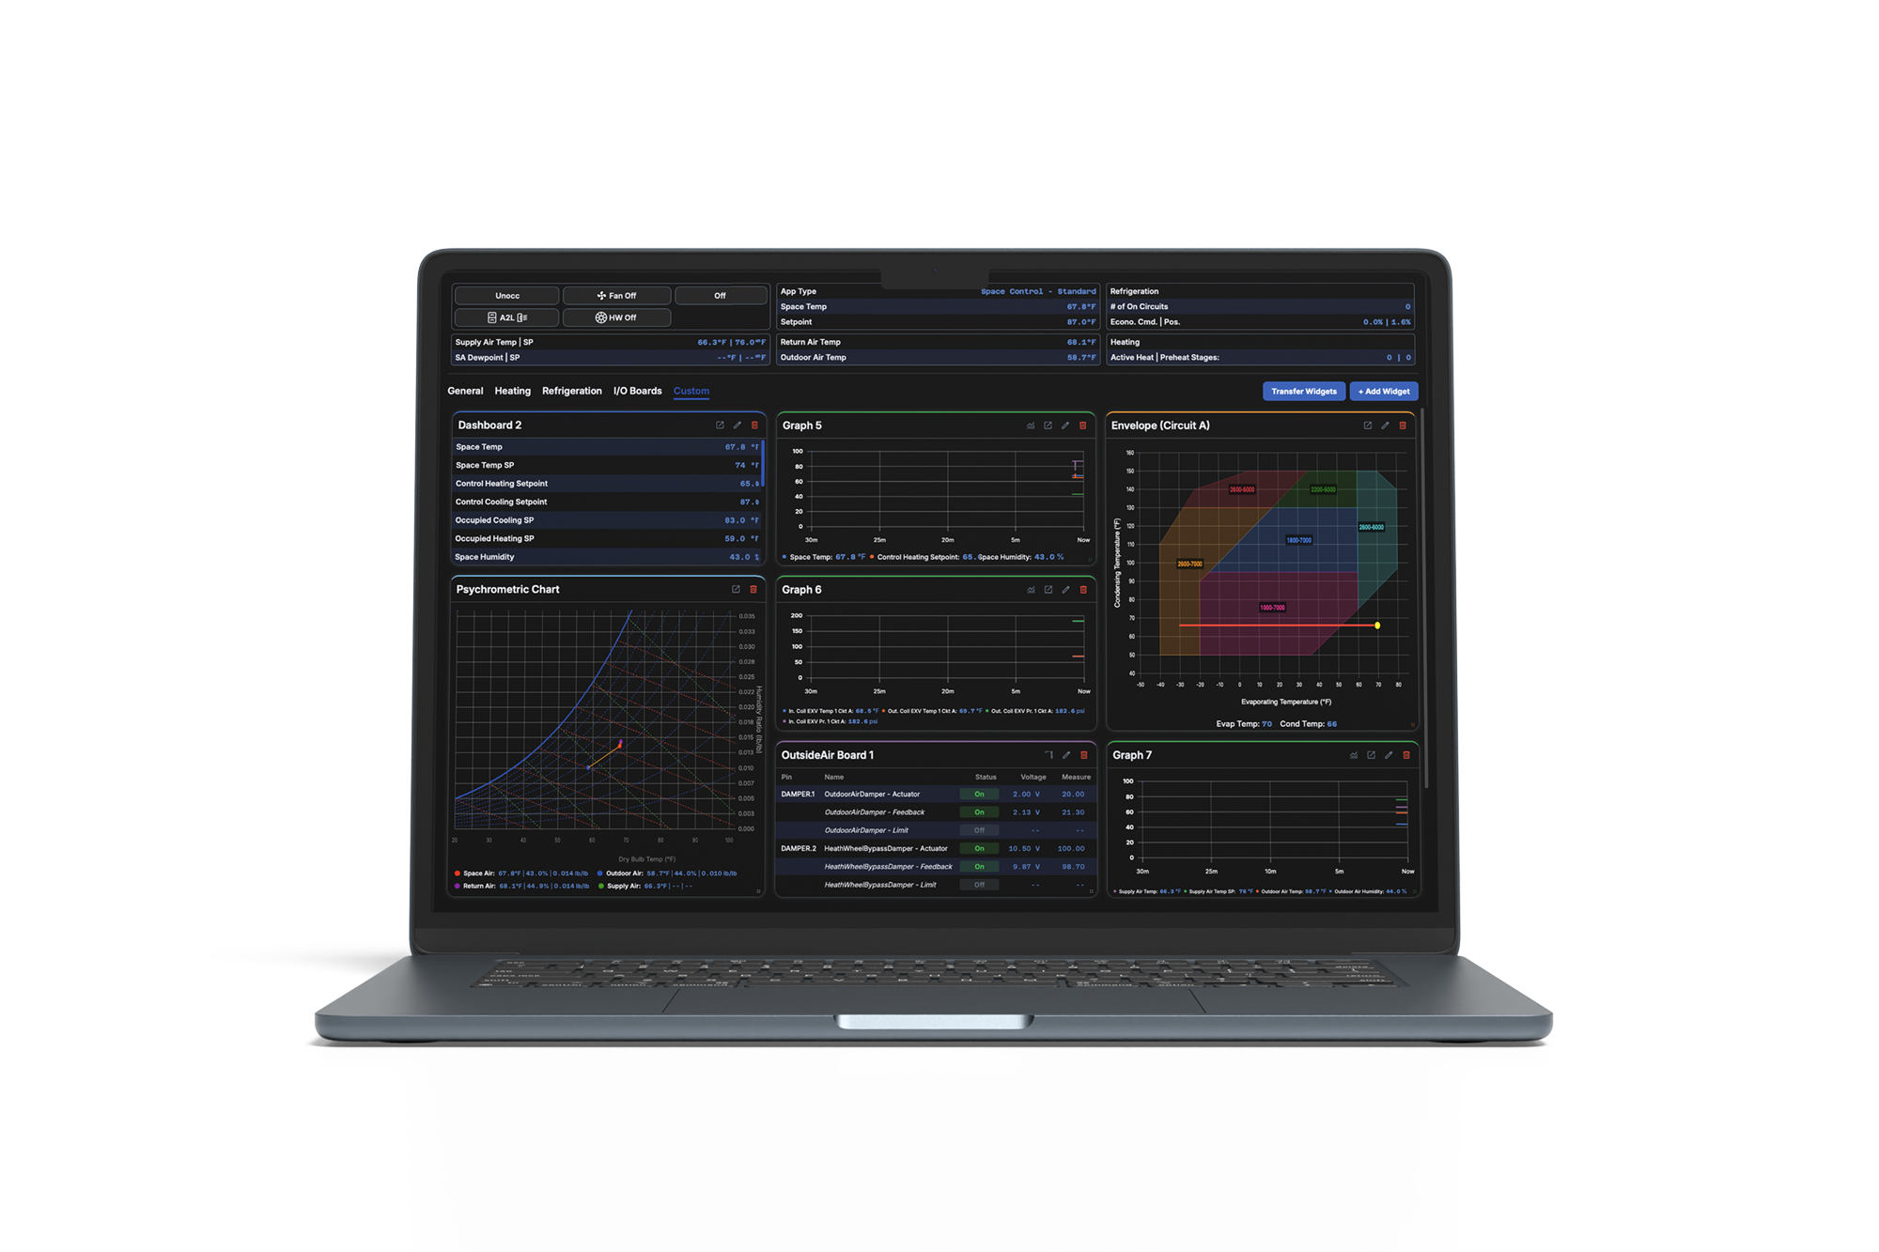
Stratus: Features and Options
Unit Manager
  — In unit touchscreen controller, allowing startup without a laptop
  — Technicians can configure and troubleshoot easily from the unit
Workstation Interface
  — Redesigned interface with customized individual dashboards
  — Monitor multiple units from one screen
  — Real-time data and alarming
Notes:
Stratus is accessible wherever you are - at the unit, at your desk, or on your phone. Whether you’re managing one unit or many, the system provides the right level of visibility and control without unnecessary complexity.

Slide 10
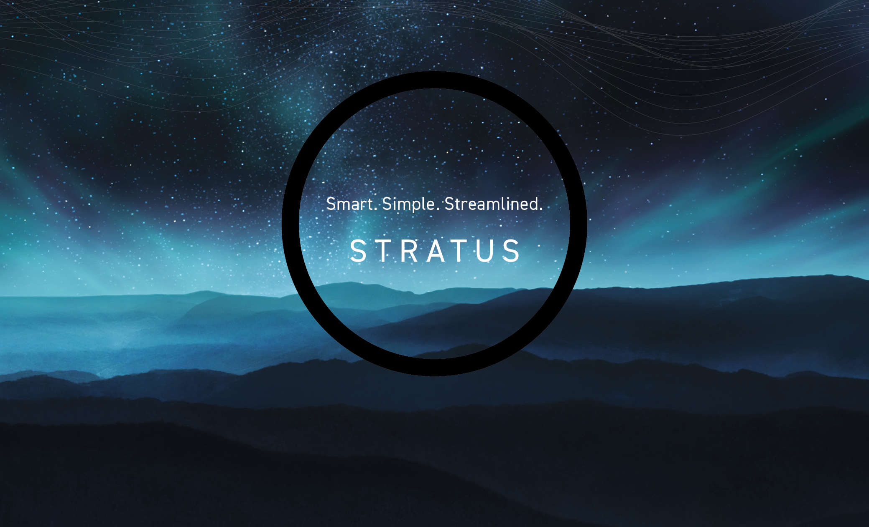
This is only the beginning for Stratus and for AAON Controls.
Order Stratus today with your next AAON unit.
Notes:
Stratus isn’t just an upgrade - it’s a shift in how controls are designed, implemented, and experienced. This is just the beginning for AAON controls, and Stratus is leading the way. We encourage you to specify or order Stratus with your next AAON unit and experience what smart, simplified controls can truly deliver.

