Slide 1
How to Submit an AAON 2-Step
Warranty Claim with XOi
A Step-by-Step Guide for Submitting the 2-Step AAON Warranty Claim
2-Step Workflow – A 2-part workflow for 2 parties that are responsible for submission through completion.

Slide 2
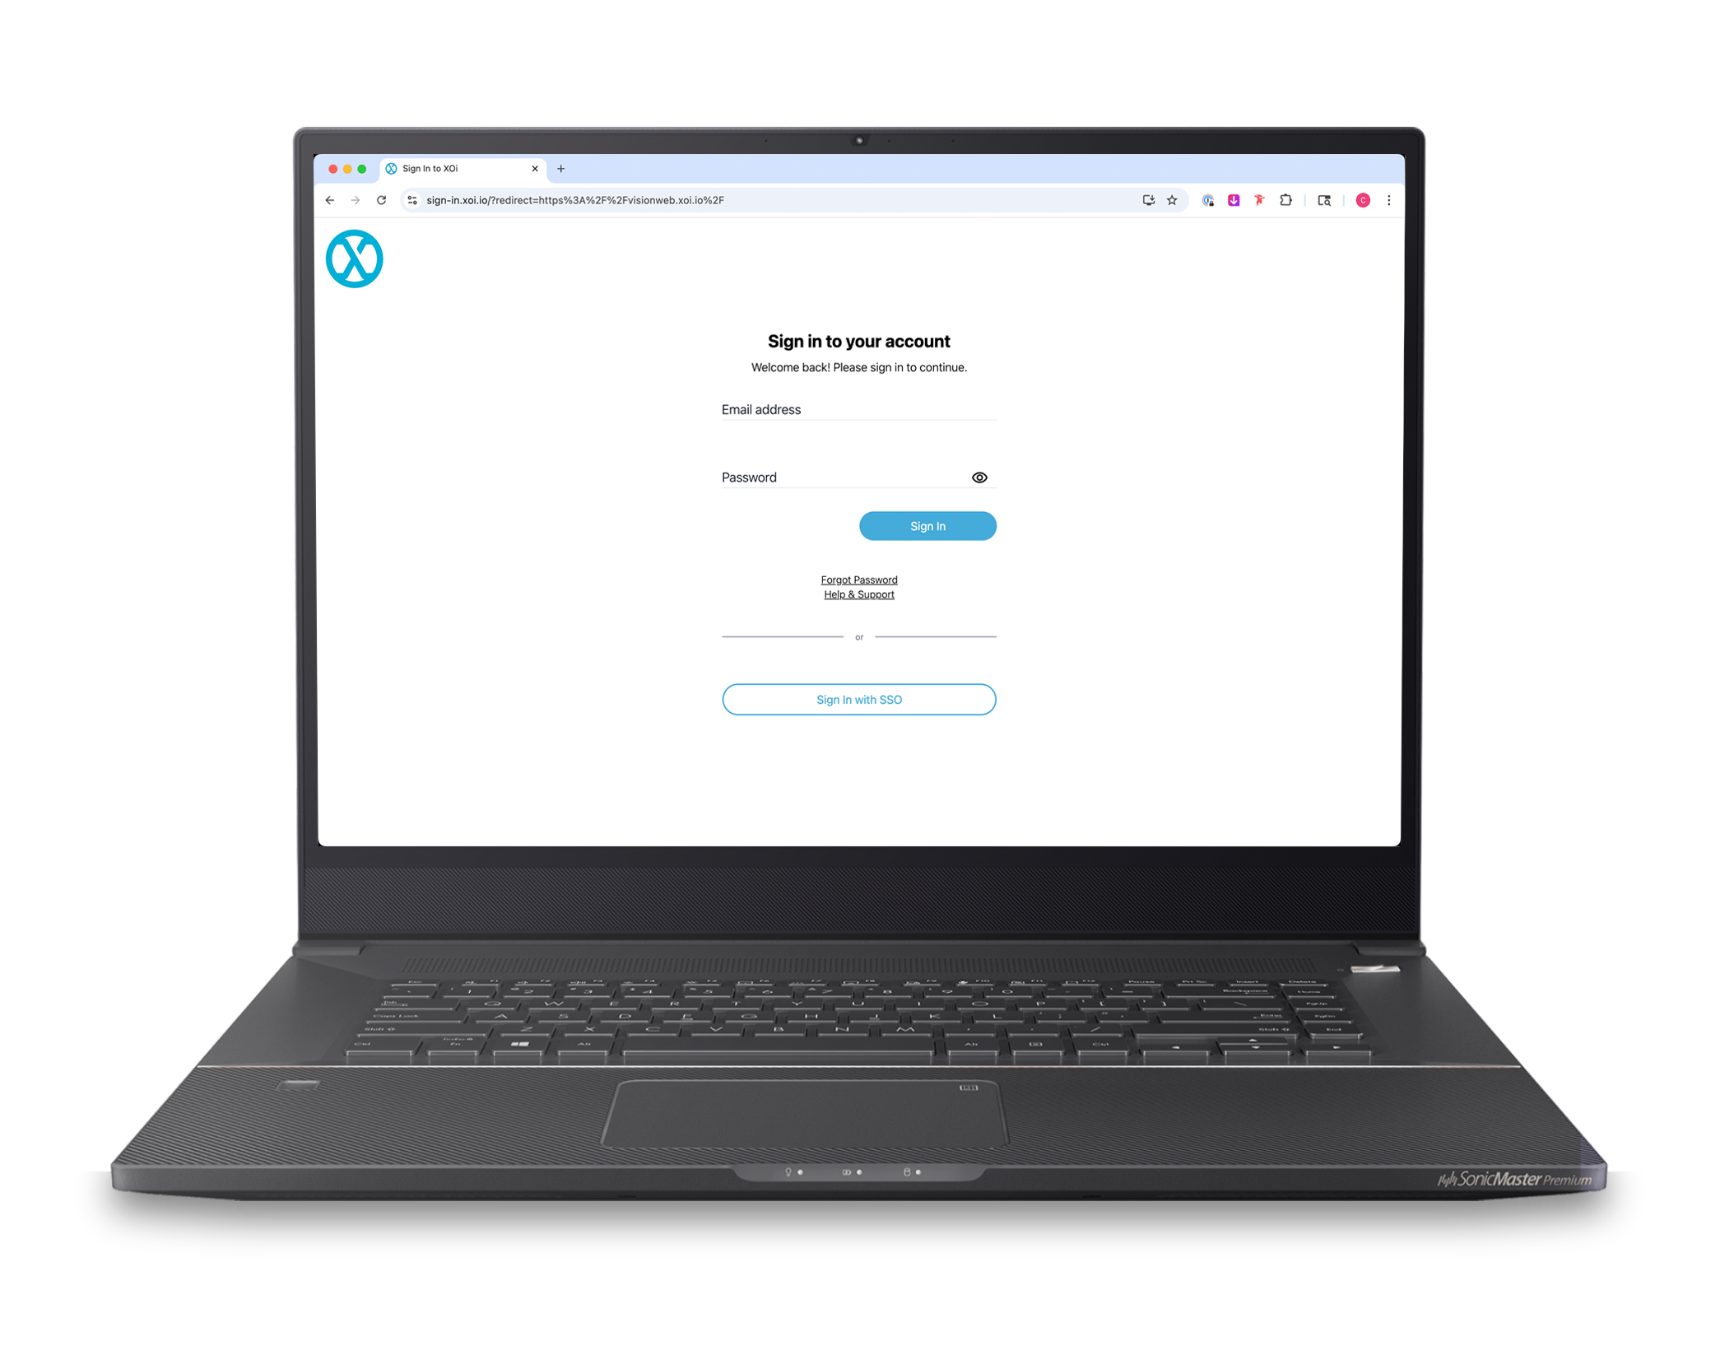
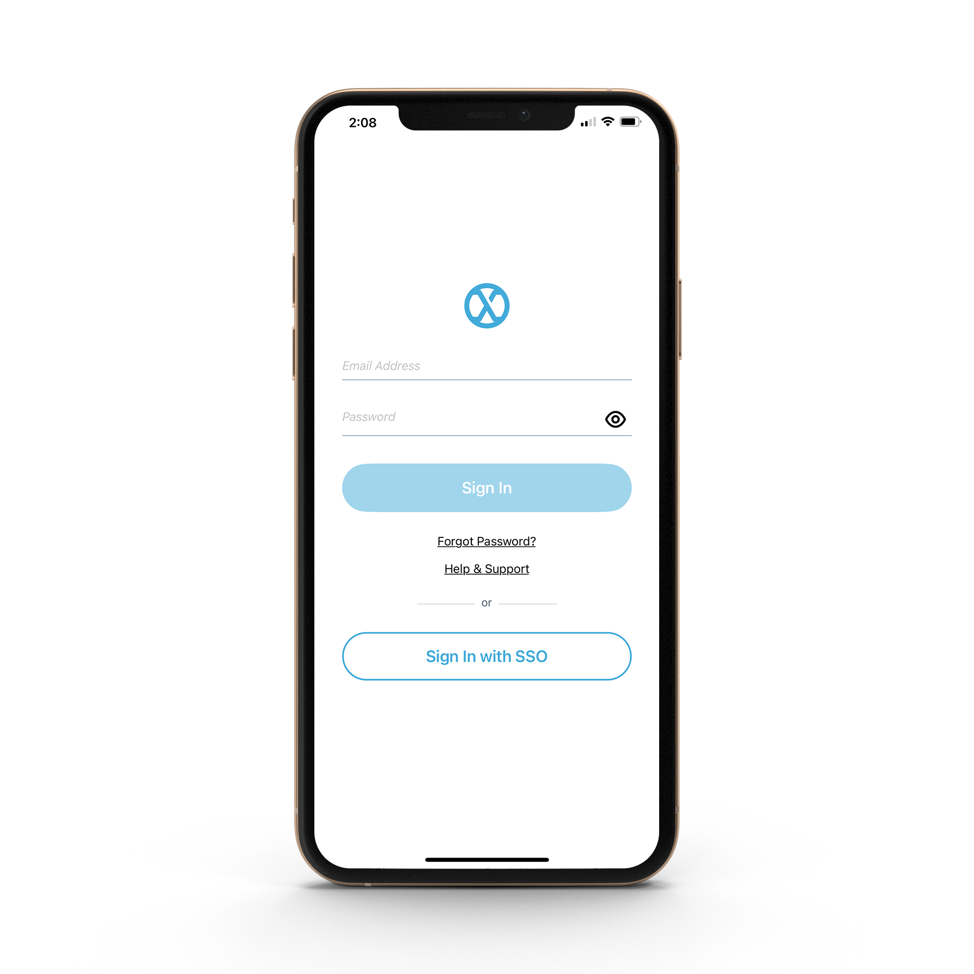
2 Ways to Submit an AAON 2-Step Warranty Claim
Important! Our goal is to approve claims within 24hrs. However, during the summer months, processing times may be longer.
On average, 80 to 85% of claims are completed – from submission to shipment – within 5 business days. Please note assembly, manufacturing, and shortages of parts may cause a claim to be processed outside of the 5-business day target.
From Desktop Visit:
visionweb.xoi.io
From Mobile Device Download Free:
XOi Vision Live App

Slide 3
AAON Warranty Contacts:
For warranty claim inquiries before claim approval | XOi.admin@aaon.com
For warranty claim inquiries after a claim has been approved | AAONwarrantyorders@aaon.com
For XOi training and XOi questions | Micheal.Plummer@aaon.com
To request XOi license to use XOi | Helen.Dennis@aaon.com
NOTE: Please remember to read all workflow step instructions for detailed warranty requirements.
Not following warranty requirements can cause a delay in the claim or even a denial.

Slide 4
How to Submit a 2-Step Warranty Claim from Desktop

Slide 5

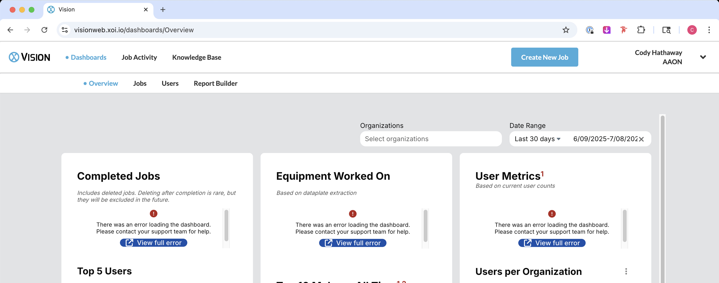
Step 1: To Submit a 2-Step Warranty Claim:
The field technician will first log in to XOi at visionweb.xoi.io
Then click the blue button “Create New Job”

Slide 6
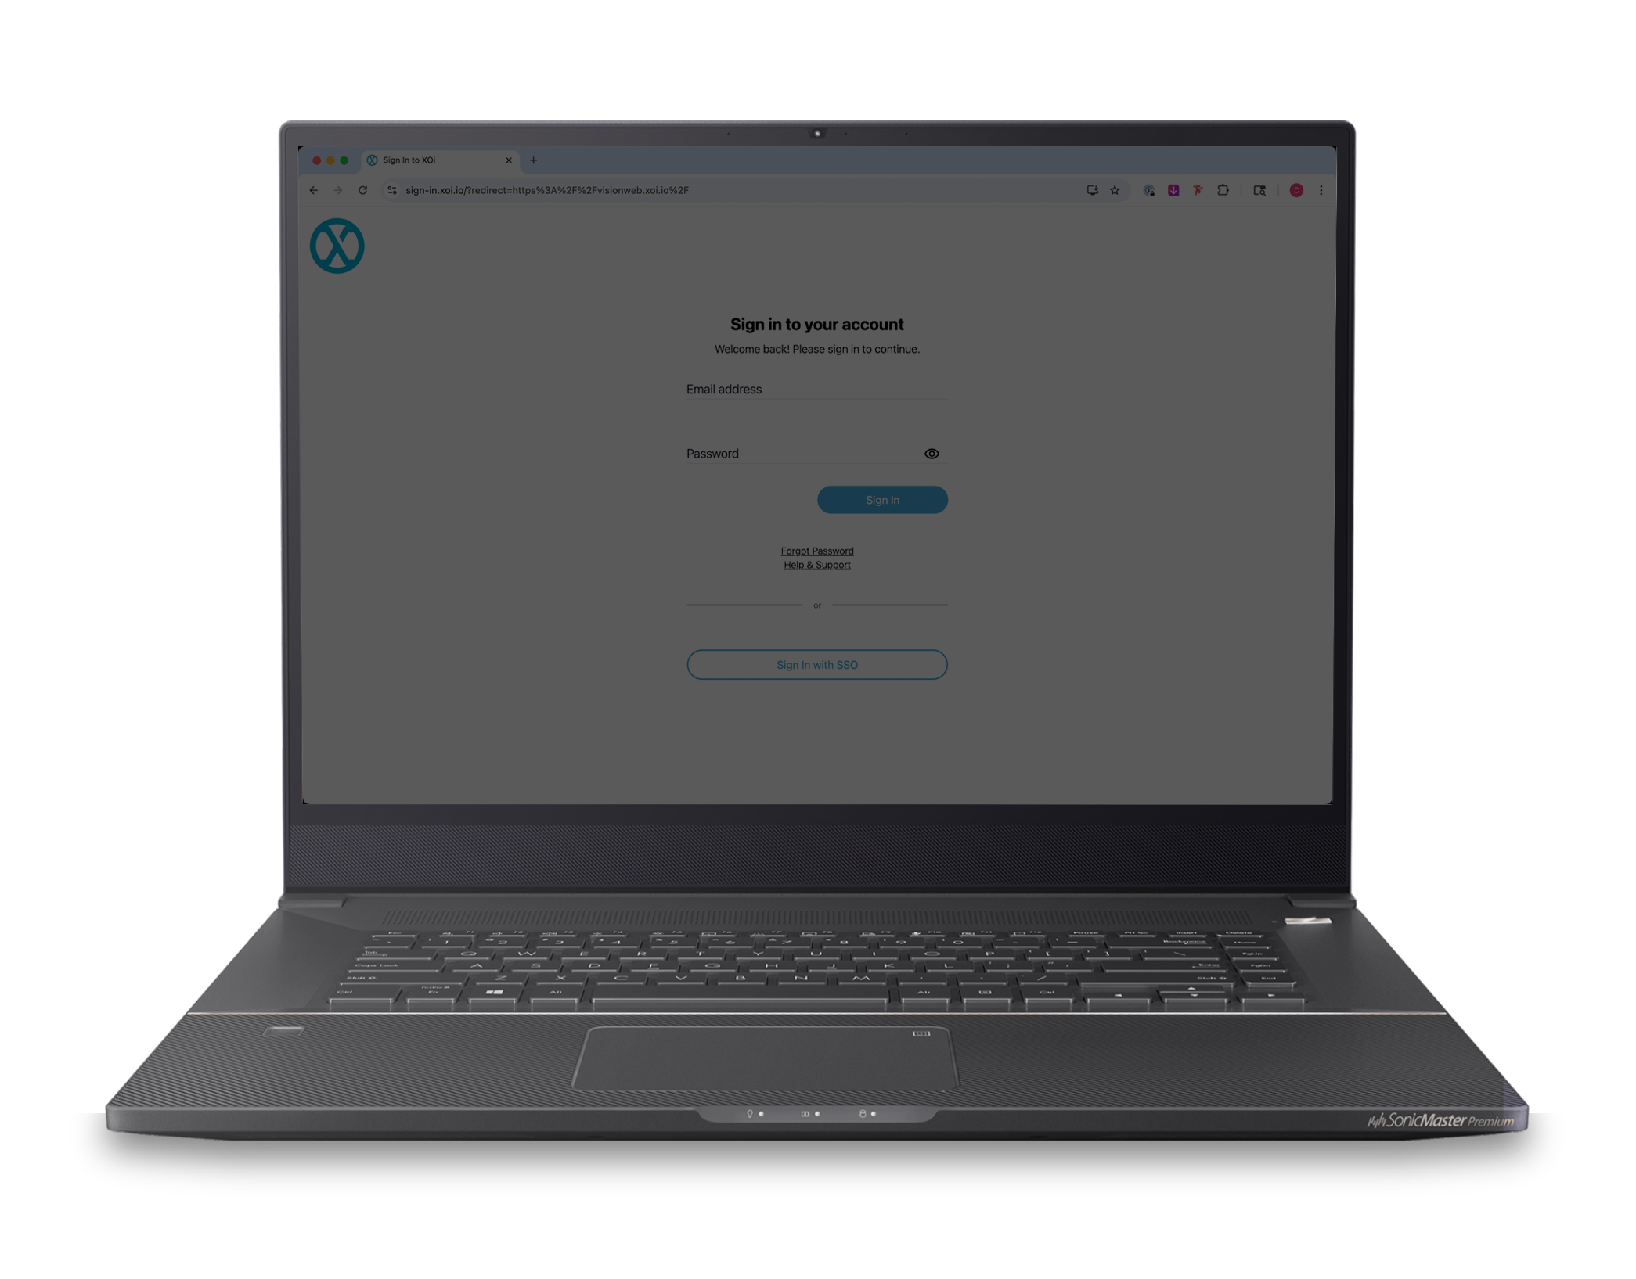
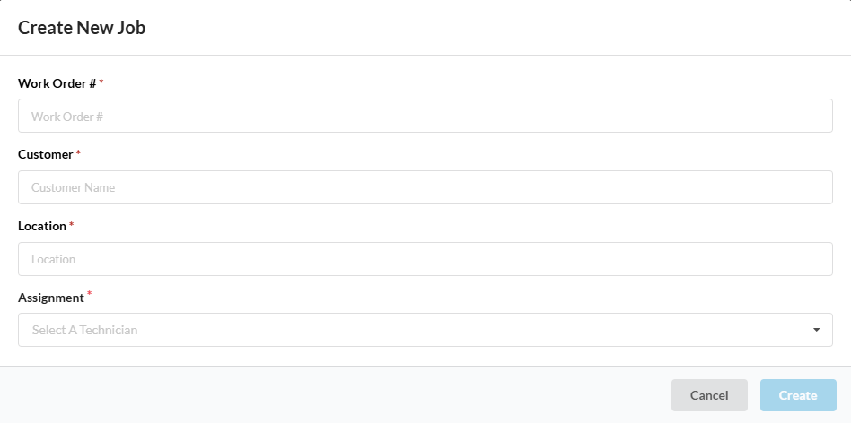
Step 2: The Field tech will click “Create New Job”
Note: Information inserted here is for your Rep Office purpose and searchability.
Insert work order number
Please contact your admin to determine the preferred Work Order Number generation. You must enter a unique Work Order Number every
Add customer name
Enter job site address
Assign the ticket to your email address to start a warranty claim
Then click “Create”
XOi will utilize your Work Order and Location information to generate a Case Title. See page 8 for example.

Slide 7
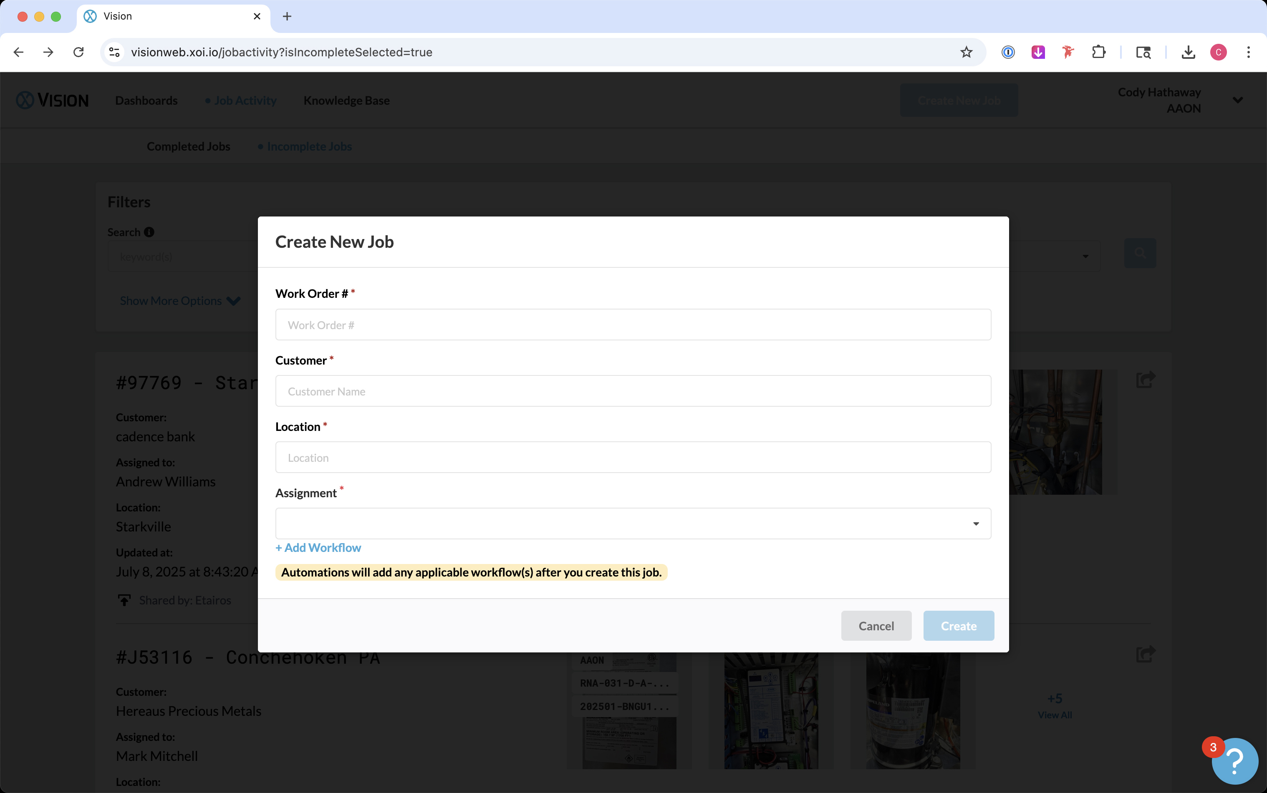
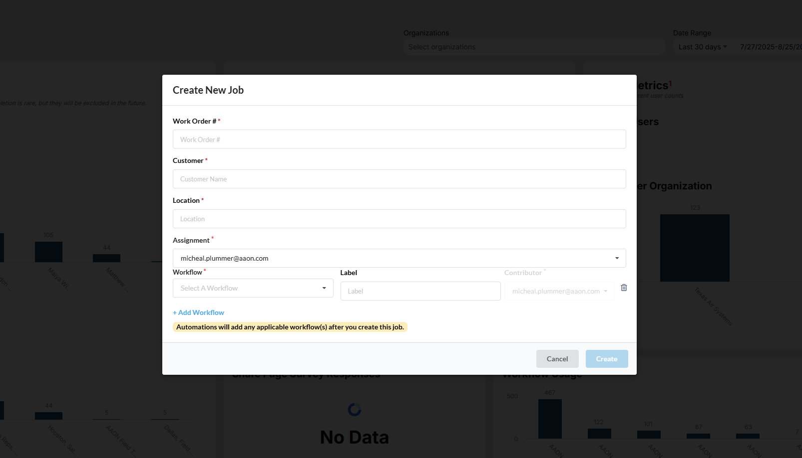
Step 3: Click on the Blue “Add Workflow”
Then Click “AAON Warranty Claim” from the drop-down list.
AAON Warranty Claim - Submit for warranty replacement parts.
AAON Group Claim – Use when filing a claim that involves multiple units on the same jobsite.
AAON Quality Report – Submit when no parts or labor are needed, but you want to notify the Quality Department of an issue.
AAON Start-Up – Upload Start-Up Forms.
AAON Labor (WLA) Request – Submit when requesting labor reimbursement only.

Slide 8
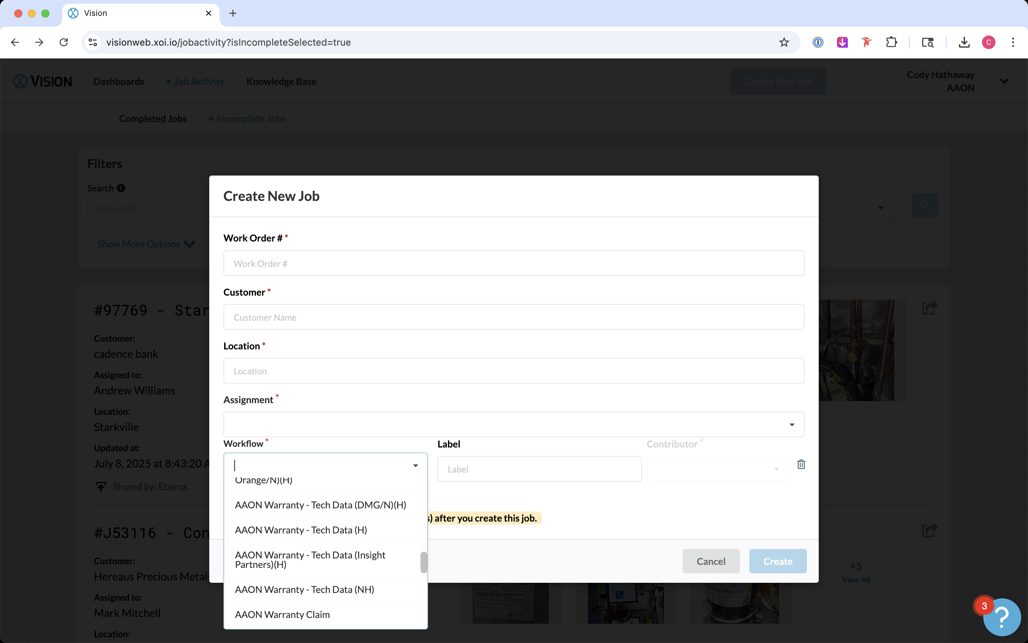
Step 3: Click on the Blue “Add Workflow”
Then Click “AAON Warranty-Tech Data” from the drop-down list.

Slide 9
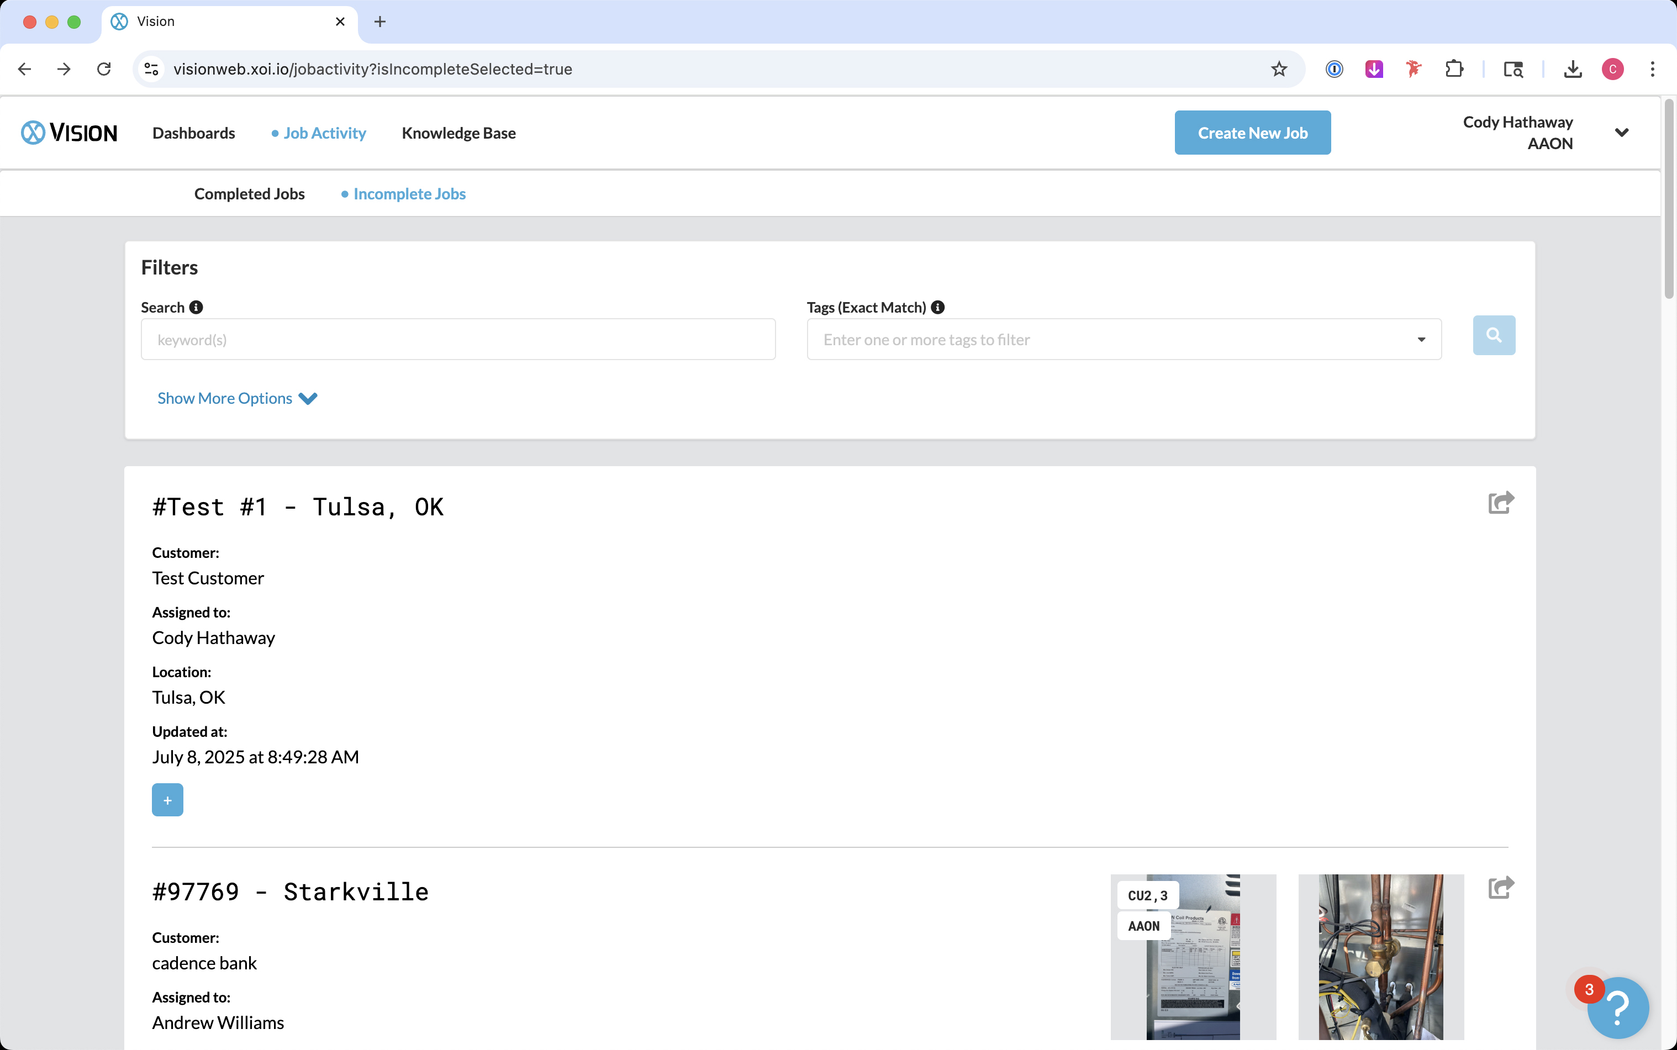
Step 4: Find Your “Job” to Complete Warranty Workflow:
First click on the “Job Activity” tab.
Then click on the “Incomplete Job” sub tab to locate the claim you have started.

Slide 10
Step 5: To Begin the Tech Data Warranty Workflow:
Click on your new Work Order # to start your warranty claim.

Slide 11
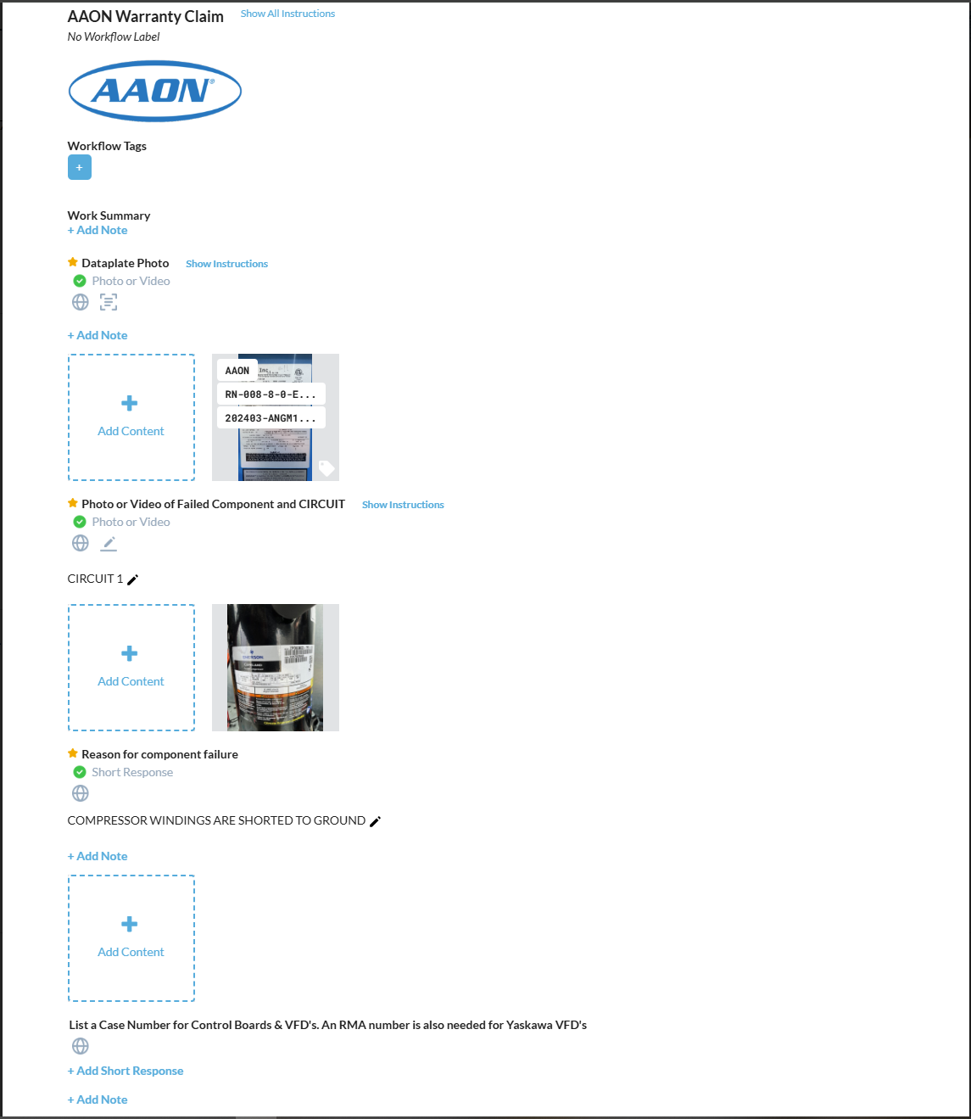
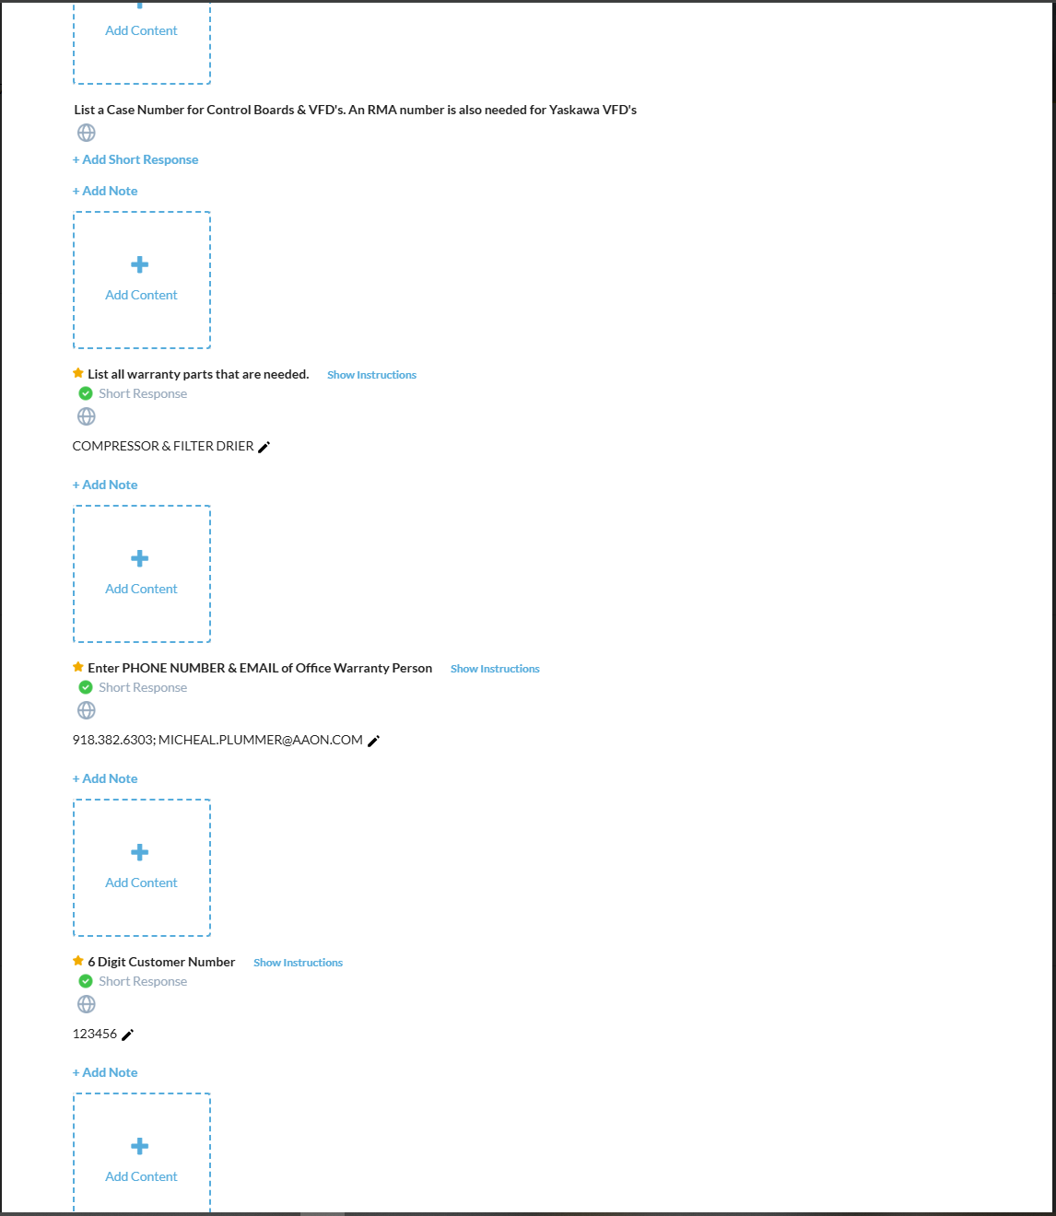
Step 6: Technician Workflow Step Requirements:
The technician is responsible for collecting the technical information for the warranty claim.
Gold Stars indicate a “required” step that must be answered before the claim can be submitted.
A green check mark appears when the required step is answered.
Please read all workflow step instructions for warranty requirements

Slide 12
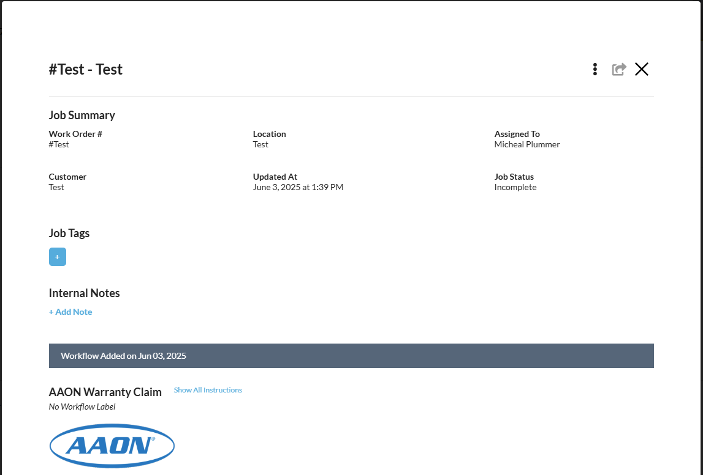
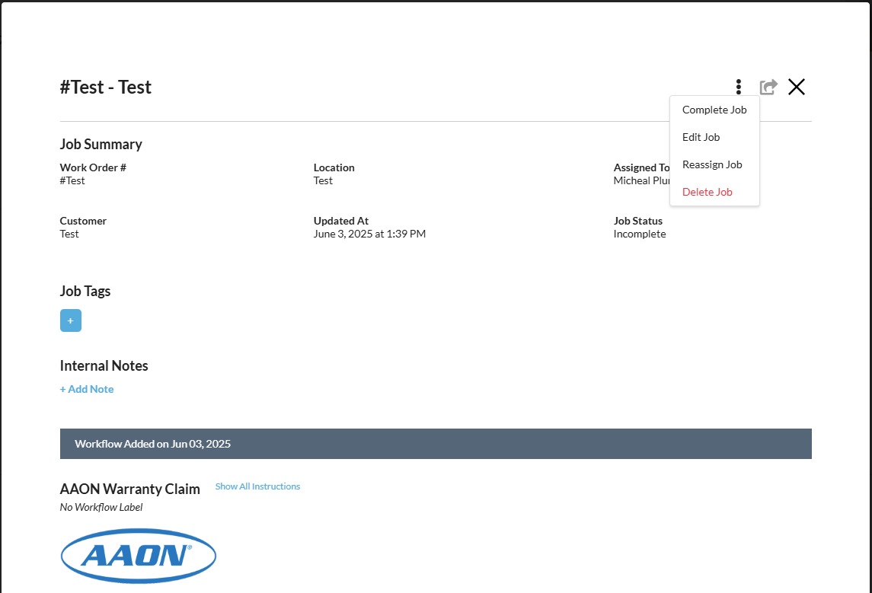
Step 7: After Completing All Tech Data Workflow Steps:
Go to the top right corner of the “Job” and click the three dots.
Then select “Complete Job.” This will trigger a notification to your office warranty administrator that a claim is submitted.
The office warranty administrator will edit the job and assign the job to their own email address.

Slide 13
Step 8: The office warranty admin will click on the Blue “Add Workflow”
Then Click “AAON Warranty-Admin Data” from the drop-down list.

Slide 14
Step 9: Warranty Admin Workflow Step Requirements:
The office warranty admin is responsible for inserting the shipping and accounting information for the warranty claim.
Gold Stars indicate a “required” step that must be answered before the claim can be submitted.
A green check mark appears when the required step is answered.
Please read all workflow step instructions for warranty requirements

Slide 15
Step 10: After Completing the Warranty Admin Data Workflow Steps:
Go to the top right corner of the “Job” and click the three dots.
Then select “Complete Job.” This will trigger a notification to AAON that a claim is submitted.

Slide 16
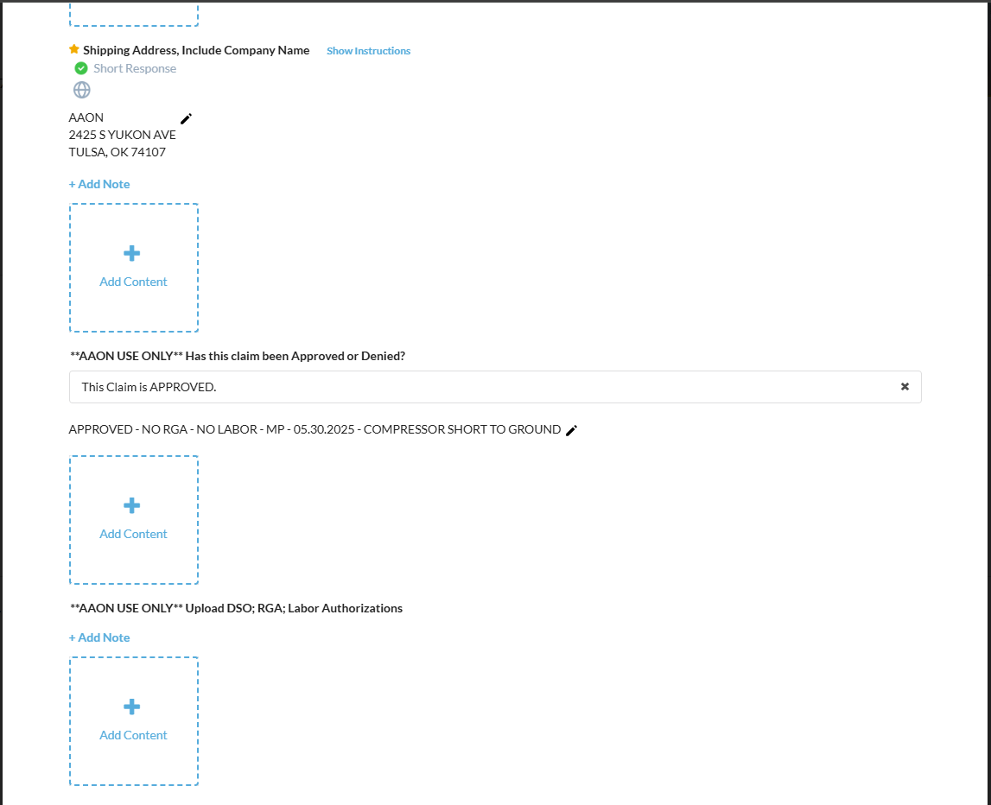
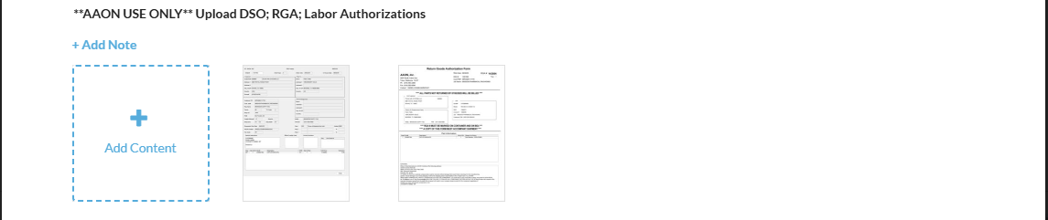
Where to Collect Warranty Documents:
Check the status of the claim as it is being processed by checking the claims approval line located at the bottom of each “AAON Warranty - Tech Data” workflow.
You can also collect warranty documents such as the DSO, RGA, and Labor Authorizations.
**AAON USE ONLY** Has this claim been Approved or Denied?
**AAON USE ONLY** Upload DSO: RGA: Labor Authorizations

Slide 17
How to Submit a 2-Step Warranty Claim from Mobile

Slide 18
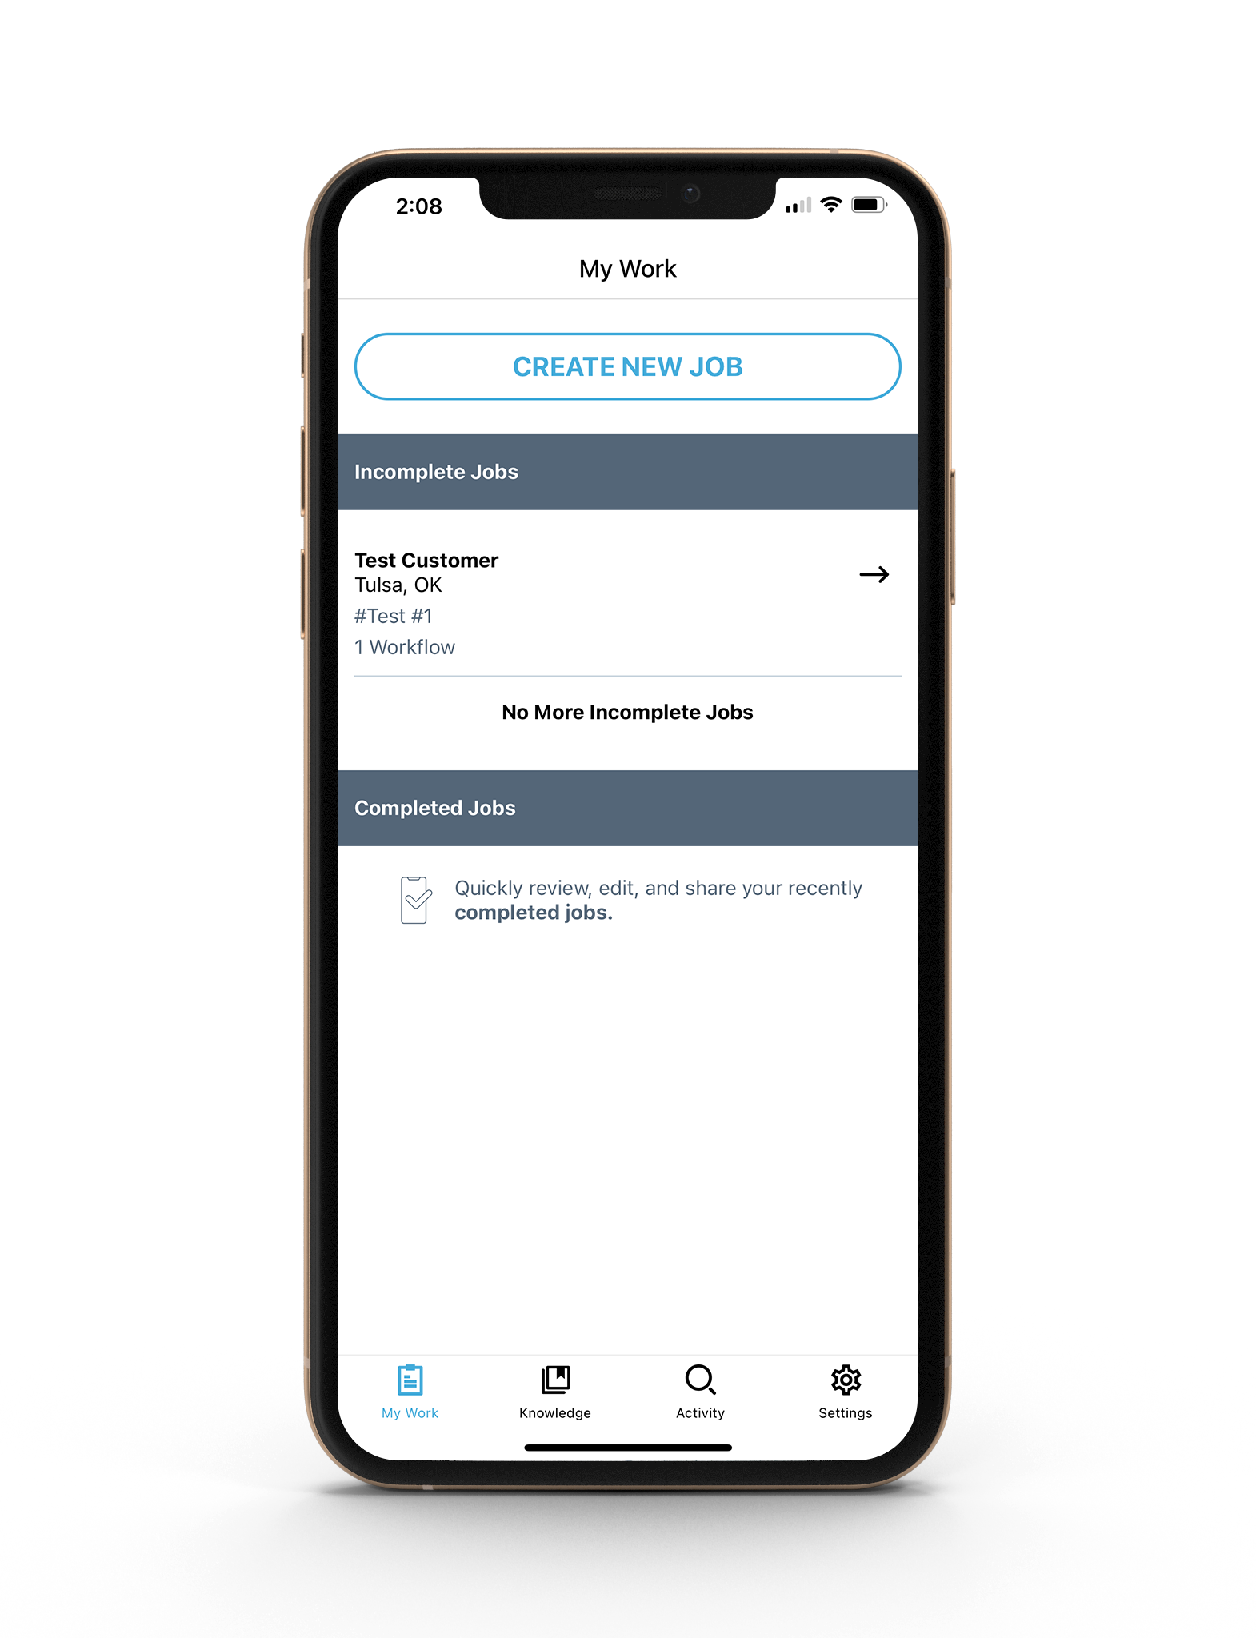
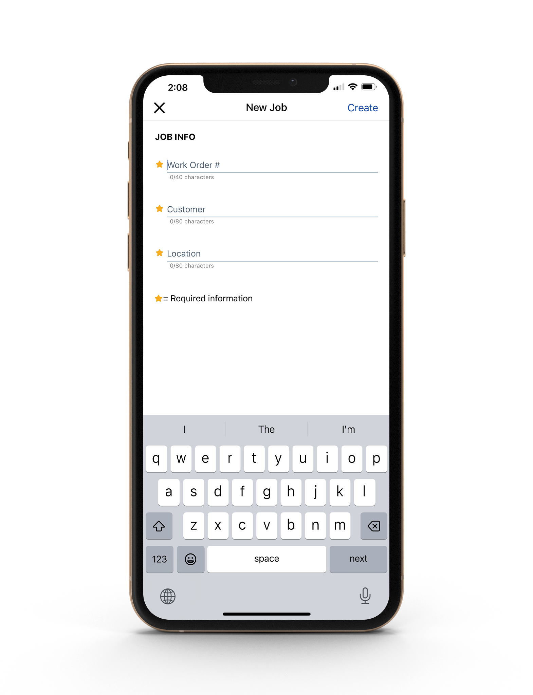
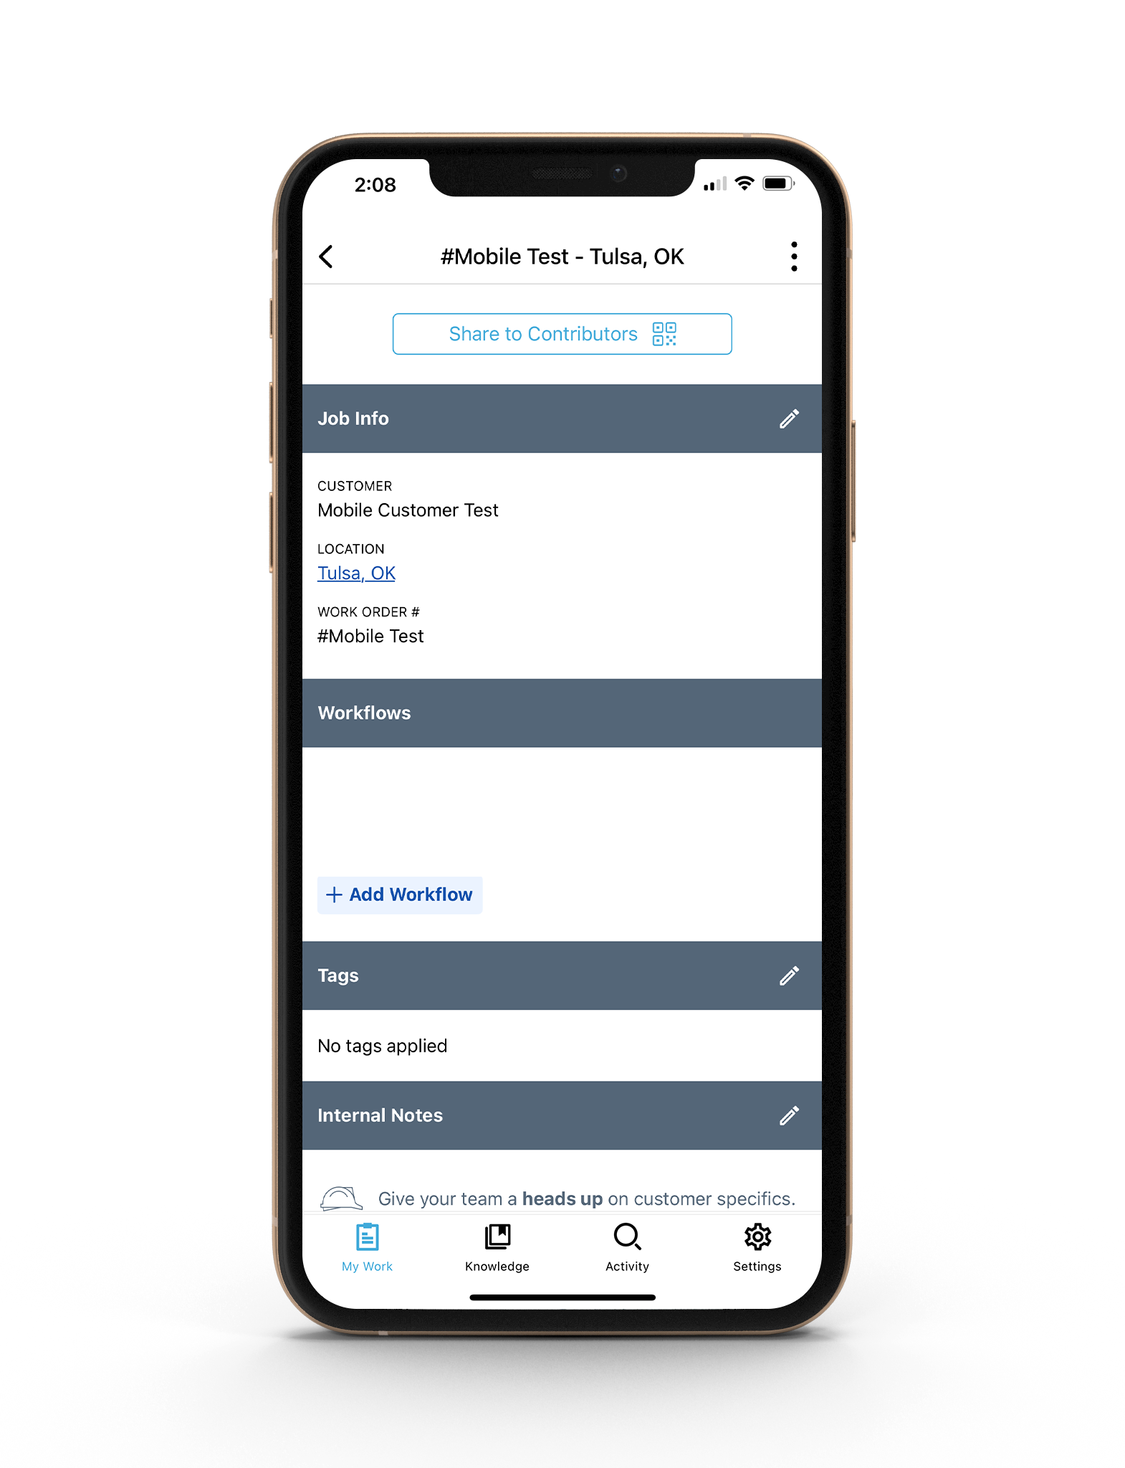
Step 1: Create New Job in Mobile App
Click the Blue Button “Create New Job”
Edit or add information by tapping the pencil icons
Tap to create a new job
Enter all required fields ⭐️
Add workflows based on the job
Add searchable tags or keywords specific to the workflow/job

Slide 19
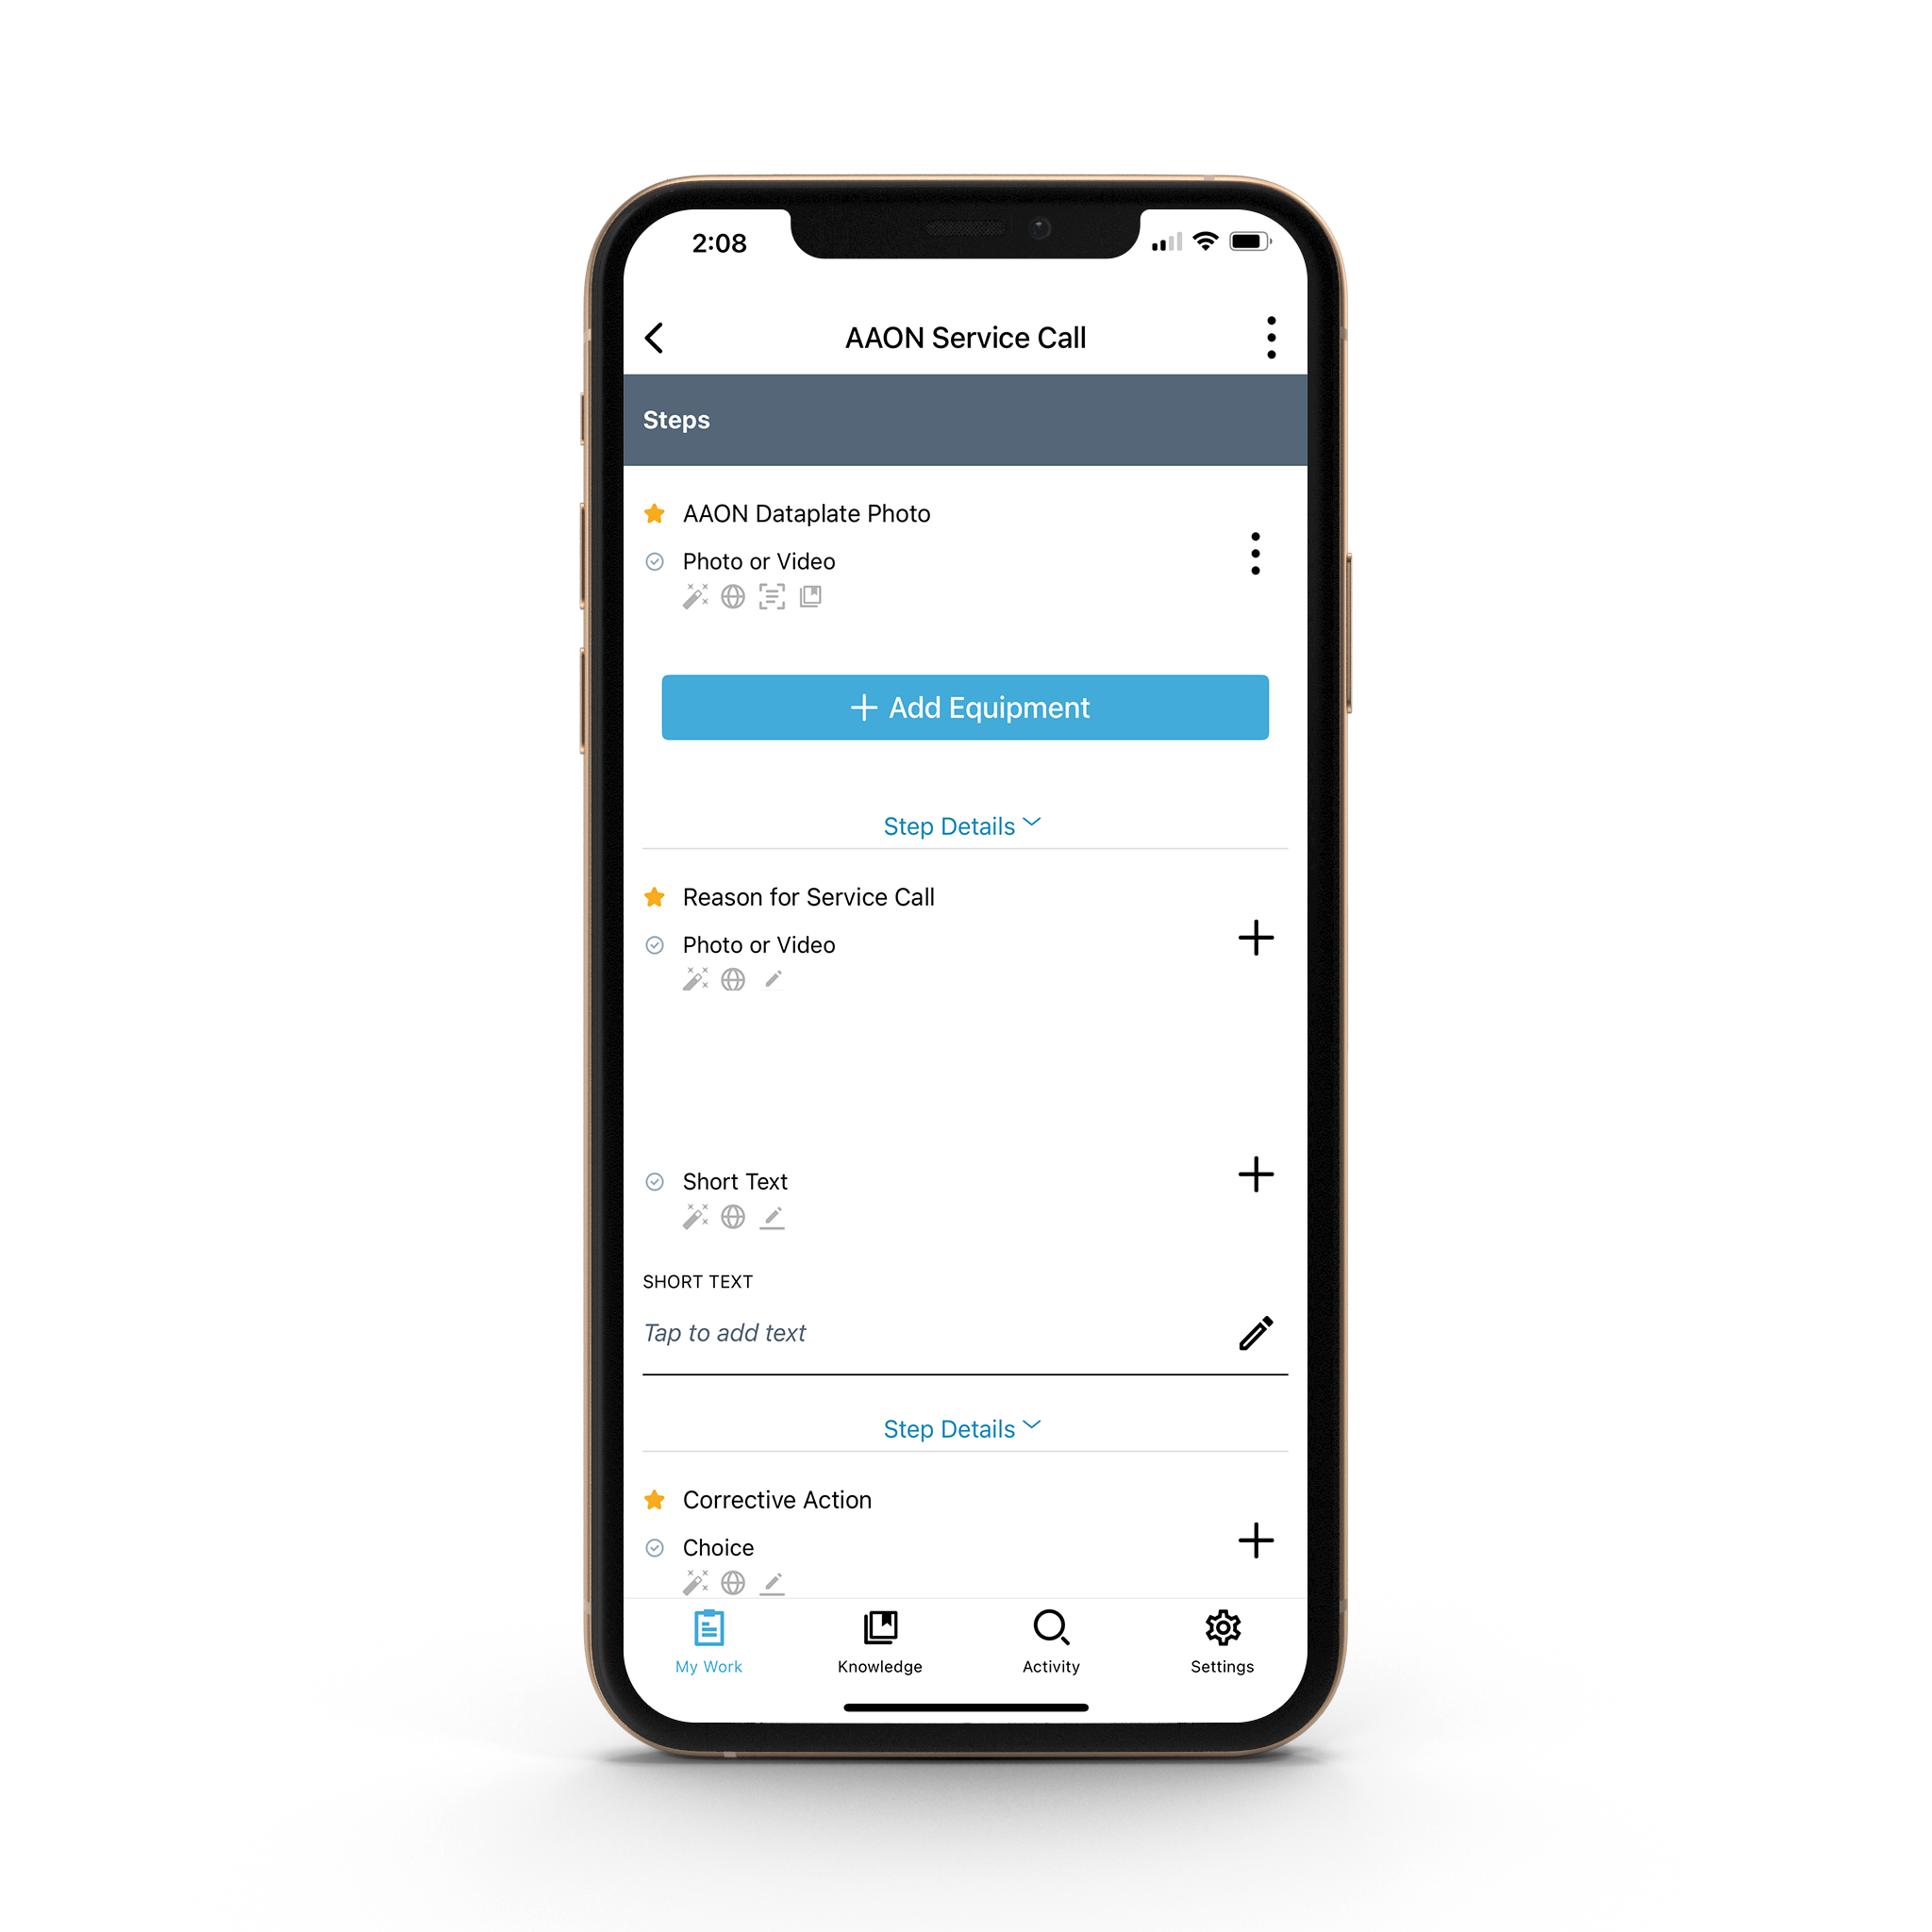







Step 2: Create New Job
The information inserted here is for your Rep Office purpose and searchability. Please contact your admin to determine the preferred method for Work Order Number generation.
Select your own work order number
Select your own customer
Add the physical address of the job site
Assign the ticket to your own email address to start a warranty claim
Then click “Create”
Label each workflow within a job
Capture a picture of a dataplate to collect valuable information, such as Make, Model, Serial Number, Mfr date, and more, with OCR* technology
Options for collecting and adding data and content to each step
= Content could be shared with customers
= Images will be submitted for Dataplate Text Extraction
Easily collect data in the field with various workflow step types
= Videos will be submitted for speech to text transcription
= Content will automatically be added to the Knowledge Base
= A workflow may be added to the job based on the answer to this step
Provide technicians with specific instructions on each step
= There is a requirement that still needs to be fulfilled
= The requirement for this step has been fulfilled

Slide 20
Step 3: Click on the Blue ”Add Workflow”
Then Click “AAON Warranty Tech Data” from the drop-down list.
Capture a picture of a dataplate to collect valuable information, such as Make, Model, Serial Number, Mfr date, and more, with OCR* technology
After completing all of the required steps, the technician will click “Finish Workflow.” This will trigger a notification to your office warranty administrator that a claim is submitted.
The office warranty administrator will edit the job and assign the job to their own email address.
Label each workflow within a job
Options for collecting and adding data and content to each step
= Content could be shared with customers
= Images will be submitted for Dataplate Text Extraction
Easily collect data in the field with various workflow step types
= Videos will be submitted for speech to text transcription
= Content will automatically be added to the Knowledge Base
= A workflow may be added to the job based on the answer to this step
Provide technicians with specific instructions on each step
= There is a requirement that still needs to be fulfilled
= The requirement for this step has been fulfilled

Slide 21
Step 4: The office warranty admin will click on the Blue “Add Workflow”
Then Click “AAON Warranty-Admin Data” from the drop-down list.

Slide 22
Step 5: Warranty Admin Workflow Step Requirements:
The office warranty admin is responsible for inserting the shipping and accounting information for the warranty claim.
Gold Stars indicate a “required” step that must be answered before the claim can be submitted.
A green check mark appears when the required step is answered.
Please read all workflow step instructions for warranty requirements

Slide 23
Step 6: After Completing the Warranty Admin Data Workflow Steps:
Go to the top right corner of the “Job” and click the three dots.
Then select “Complete Job.” This will trigger a notification to AAON that a claim is submitted.

Slide 24
Where to Collect Warranty Documents:
Check the status of the claim as it is being processed by checking the claims approval line located at the bottom of each “AAON Warranty - Tech Data” workflow.
You can also collect warranty documents such as the DSO, RGA, and Labor Authorizations.
**AAON USE ONLY** Has this claim been Approved or Denied?
**AAON USE ONLY** Upload DSO: RGA: Labor Authorizations

Slide 25
Key Takeaways

Slide 26
Key Points:
Log in to XOi at Visionweb.xoi.io from desktop or download free XOi Vision Live mobile app.
A step with a gold star is “required” and must be answered to submit a warranty claim.
Collect warranty documents in the warranty claim workflow.
For warranty contacts, please see the following:
For warranty claim inquiries before claim approval - | XOi.admin@aaon.com
For warranty claim inquiries after a claim has been approved - | AAONwarrantyorders@aaon.com
For XOi training and XOi questions - | Micheal.Plummer@aaon.com
To request XOi license to use XOi - | Helen.Dennis@aaon.com
NOTE: Please remember to read all workflow step instructions for detailed warranty requirements.
Not following warranty requirements can cause a delay in the claim or even a denial.

Slide 27
Thank You

